Slide 1
User Attributes - Scenario
Scenario:
We need a new character code for projects to describe the risk level. We should also have a difficulty level number for each activity within the project!
Analysis:
User attributes allow you to create additional attributes on a given class which is perfect for when your manager wants to track more and more information within Plansiware.
How to break down the situation: 1. Figure out relevant objects - Project, Activity 2. Determine the type of data needed - Character, Number

Slide 2
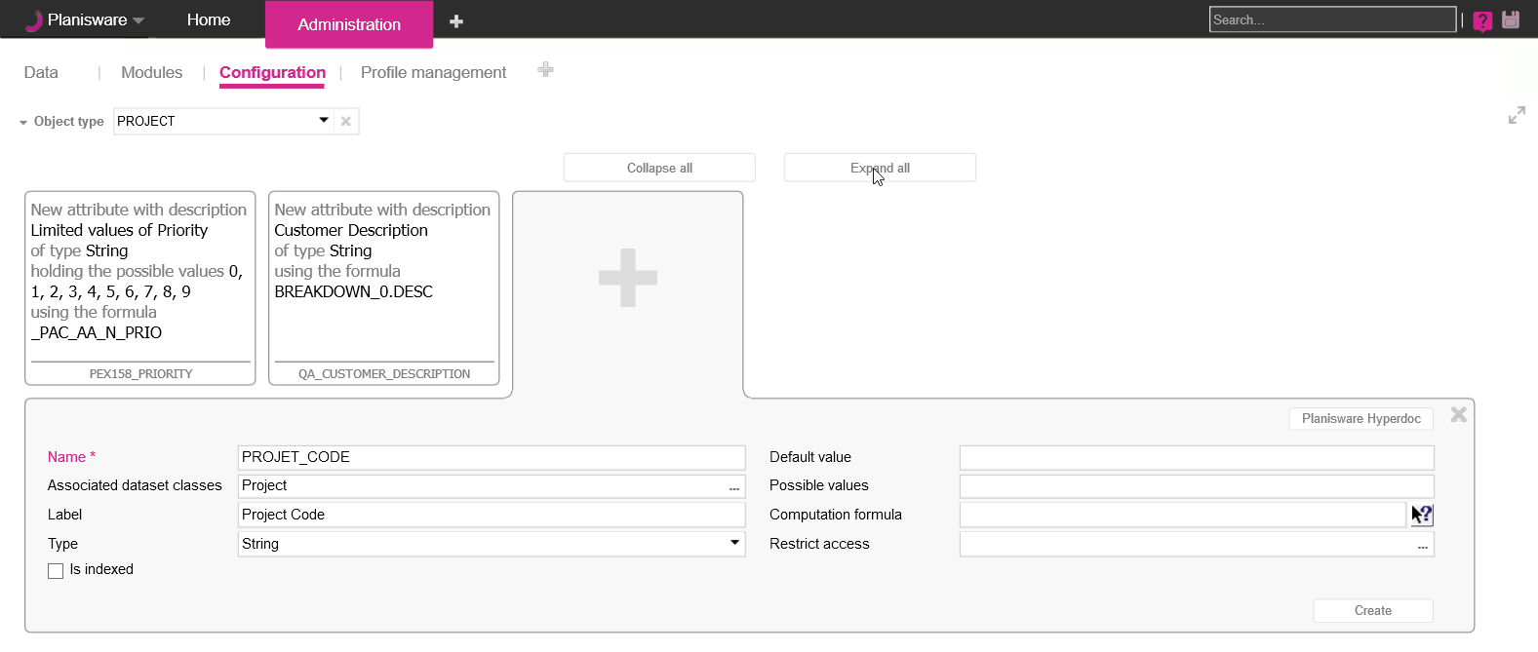
User Attribute Creation
1
2
3
5
4
Select the relevant object from the analysis
Click on the + button of the user attribute section to create a new user attribute
Give your attribute an appropriate Name and Level
Name – Check with your admin to see if you have a naming convention to use
Label - Use a description that makes it easy for end users to understand
Select the correct Data Type from the analysis
Default value of attribute when an object is created
1
2
3
4
5

Slide 3
Exercise
Create your own Project code user attribute:
Name = XX_UA_S_PROJECT_CODE (where XX are your initials)
Convention: 3 Letters of your company
Label = XX Project code
Type = String
Go to the Project module and insert your attribute in the Projects table
Fill out the attribute for a few projects

Slide 4
User Attributes - Scenario
Scenario
Thank you for adding the attribute to the project! Don’t forget that I also needed a difficulty level number for each activity within the project!
Analysis
User attributes allow you to create additional attributes on a given class which is perfect for when your manager wants to track more and more information within Plansiware.
How to break down the situation: 1. Figure out relevant objects - Project, Activity 2. Determine the type of data needed - Character, Number

Slide 5
Exercise
Create your own user attribute based on the above scenario:
Remember the following – Naming convention
Class
Type

Slide 6
User Attributes - Scenario
Scenario
The new project code works great! The difficulty level for activities needs improvement, though. Too many users are entering different values and it is confusing all the PMs. Can we have a dropdown selection for difficulty levels between 1-5 and only have PMs be able to view and edit this attribute?
Analysis
How to break down the situation: 1. Using Possible Attribute Values will limit user input to a set of specified values. There are 2 ways of implementing this feature.
2. Setting the restrict access value of a user attribute lets admins control which users or which user groups can view the user attribute within the system

Slide 7
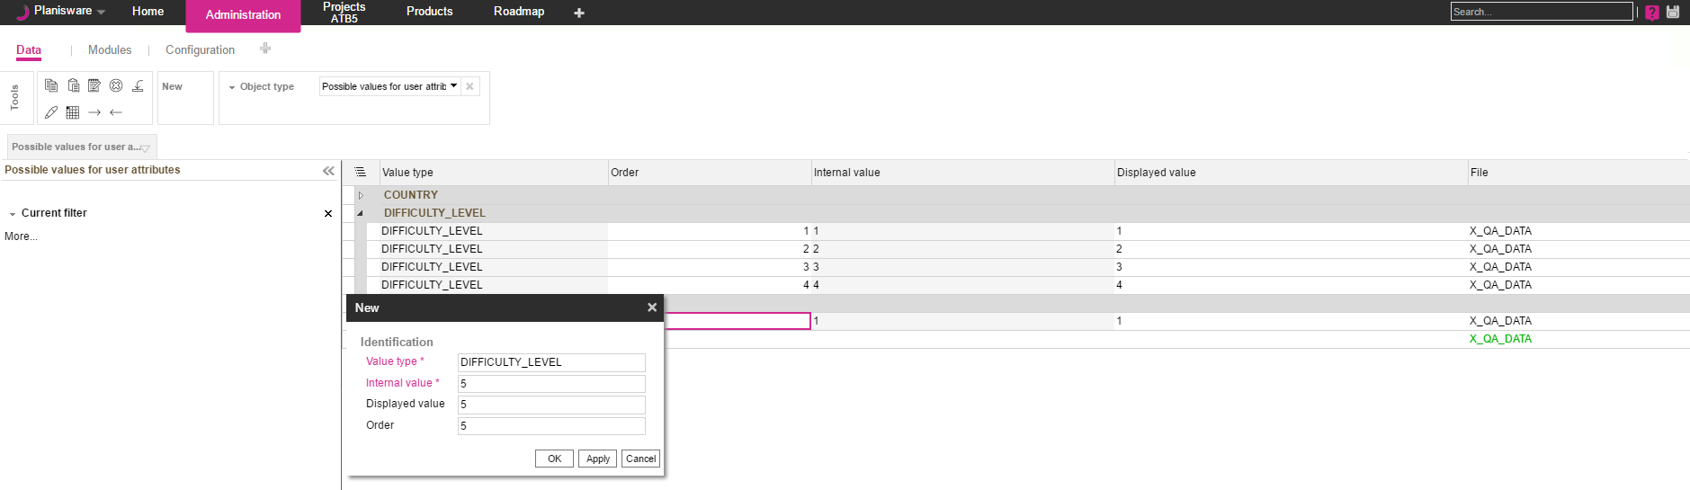
Possible attribute values table
1
4
2
3
Planisware has an OOB Administration Table that maintains lists of possible values. First go to the Administration Module -> Data Page and select Possible values for user attributes as the object type
Clicking on the “New” tool allows admins to create a new “Possible Value” entry. Value choices are grouped into value types.
Possible Value lines can have the following attributes defined:
Internal value – The value stored in the database
Displayed Value - The value displayed in a table or in reports Order - The order the possible value is displayed
All of the Possible values for Difficulty Level can be seen in the table
1
2
3
4

Slide 8
Exercise
Create a dropdown list for your own user attribute:
Go to administration -> Data and select ‘Possible values for user attributes’ object type
Create three values:
Value type = XX_DIFFICULTY_LEVEL
Internal value = Low, Medium and High
Displayed value = Low, Medium and High
Assign the possible values type to a new project user attribute:
Name = XX_UA_S_DIFFICULTY_LEVEL
Label = XX Difficulty level
Type = XX_DIFFICULTY_LEVEL
Test the attribute and possible values dropdown from the Project module

Slide 9
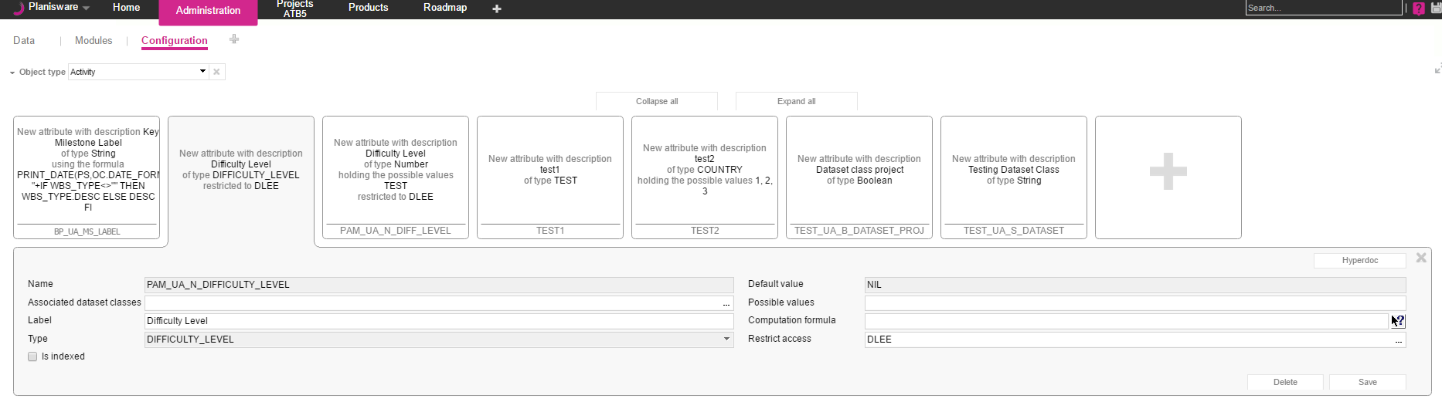
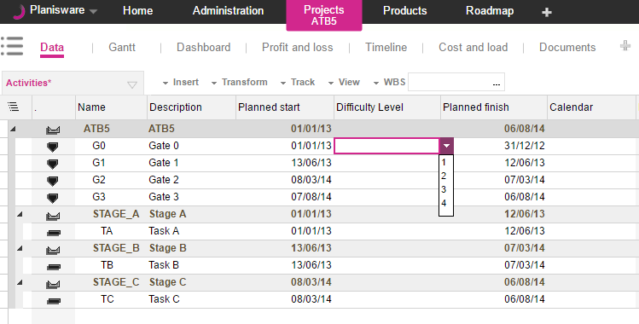
User Attributes – Possible Values
Administration
1
Activity Table:
2
A new user attribute’s type can be set to an existing value type
The dropdown choices display all possible values of the value type in the right order
1
2

Slide 10
User Attributes - Relations
Scenario
Wow this is great! I can add a lot of different data types to our model now! What if we want to link two existing classes? We have a situation! We already associate resources with skills, but there is no relationship between activities and skills. To make things more complicated, some activities need to be associated to multiple skills!
Analysis
When you need to add attributes that represent more than simple data types such as strings, numbers, and dates, but classes, this is called a relation. Relational Attributes define a relation between 1 object to another. If there is a need to map to multiple objects in a given attribute, this is called a ring attribute.
How to break down the situation: Determine which objects define the relation: activities and skills
Determine the relation direction. This will decide which object type should be configured: an Activity should list skills so the activity object should have an attribute to skills Determine if we need a relation or a ring attribute : ring attribute

Slide 11
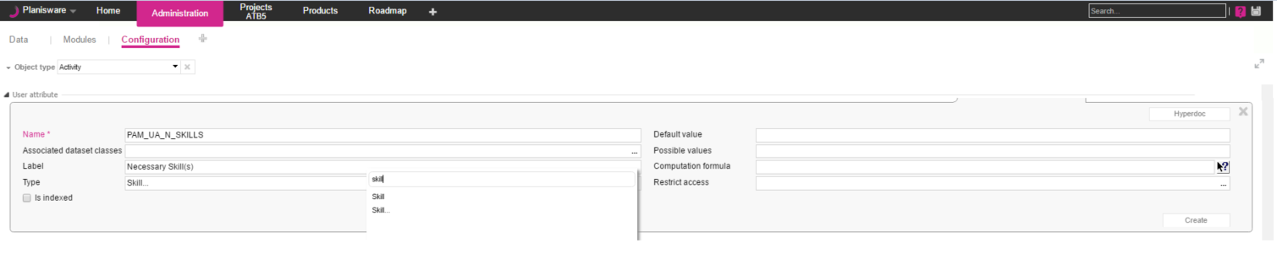
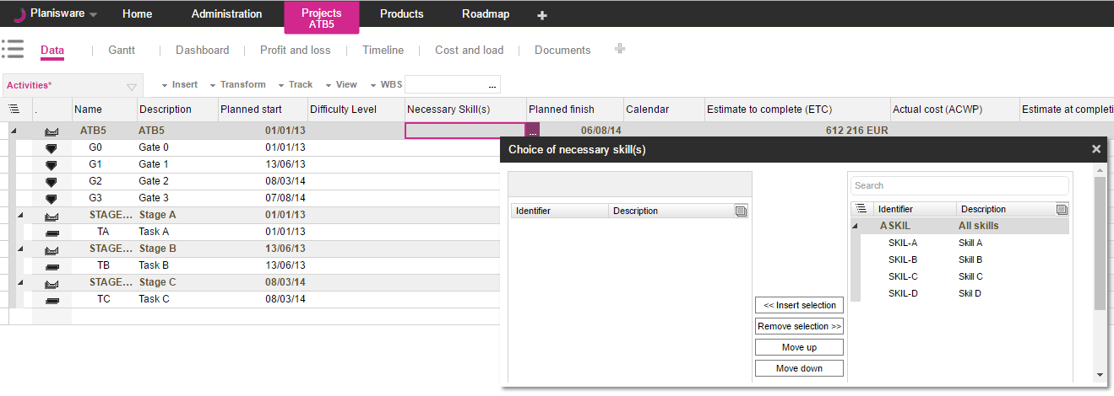
User Attributes – Relations
Administration:
1
Activity Table:
2
The Type of an administration can be set to a different class. Note that classes might have the “…” after. The “…” determines if the relation should be a ring attribute
The choices display all possible values of the value type in the right order
1
2

Slide 12
Exercise
Scenario
We need to know the primary skill associated with an activity. Also we need to know all other skills that are associated with an activity. Can we extend the data model to meet this?
Create the appropriate data model extensions
Name = XXX + ”UA_PRIMARY_SKILL”
Name = XXX + “UA_SKILLS” XXX = name of company + initials
Test the attribute and possible values dropdown from the Project module

Slide 13
User Attributes – Named Formulas
Scenario
Its nice to know that we can extend our data model to include everything from simple data to all types of relational data! What if we need to perform some calculations? We want to have a simple project prioritization based on multiplying a project’s Difficulty level, Importance, Cost, and Leverage
Analysis
Named formulas can be used to perform a wide range of calculations and data transformations. The things to look for in a named formula are Class: Project Type : Since we are multiplying several digits we expect our type to be a number
Evaluation Formula: We will be multiplying the values of Difficulty Level, Importance, Cost, and Leverage
Note: Named Formulas can perform a wide variety of calculations that are out of scope of this class. If you would like to learn more, please inform the trainer asking about in depth training on formulas and what they can do

Slide 14
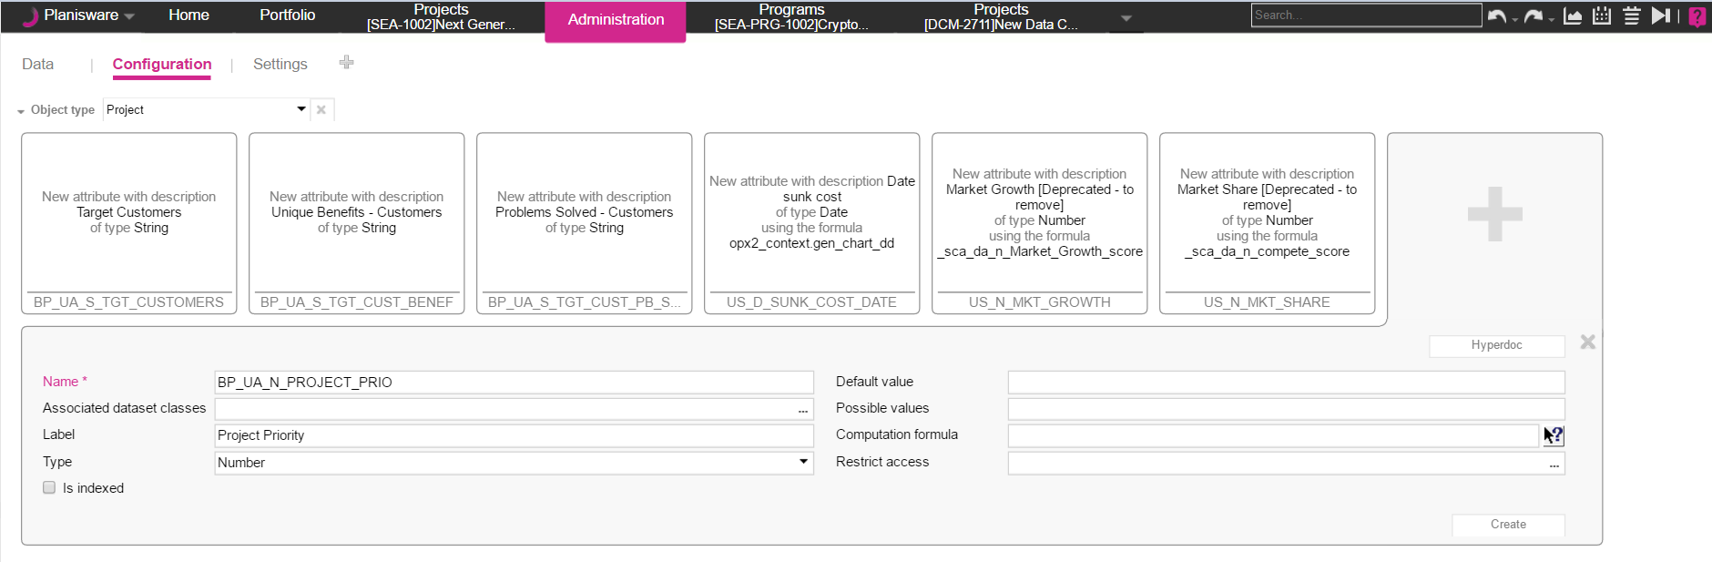
Data model extension: named formula
1
Select the Object Class of the Named Formula Select the name, Label, and return Type of the Named Formula Click on the icon next to the computation formula to open up the formula builder form
2
3
1
3
2

Slide 15
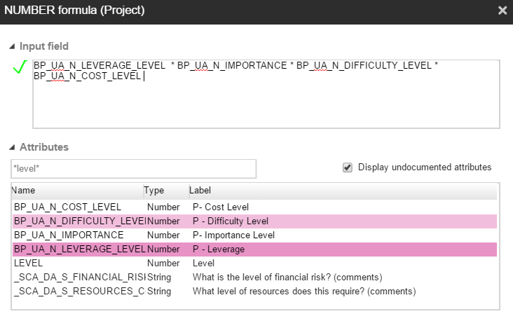
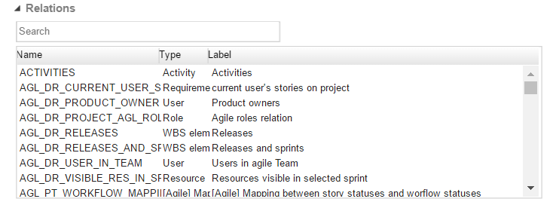
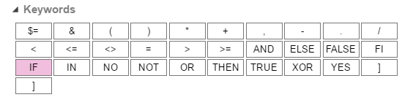
Data model extension: named formula
The Input field specifies the actual named Formula calculation
Use the attributes section to search for all attributes available on your selected class. Note that is is best practice to use the search feature
Use the relations section to search for all other classes the current class is connected to
The keywords section lists available syntax offered by Named Formulas
1
1
2
2
3
3
4
4

Slide 16
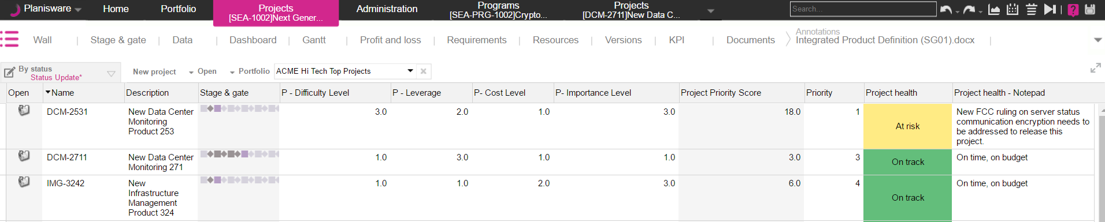
Data model extension: named formula

Slide 17
Exercise
Create a new user attribute and use a named formula to calculate its value:
Name = XX_UA_S_DIFFICULTY_FACTOR
Label = XX Difficulty factor
Type = XX_DIFFICULTY_LEVEL
Computation formula =
IF XX_DIFFICULTY_LEVEL = "Low" THEN 1 ELSE IF XX_DIFFICULTY_LEVEL = "Medium" THEN 2 ELSE 3 FI FI
Test the attribute and possible values dropdown from the Project module

Slide 18
Demo
name formula common tasks
equality
non equality <>
concat string (+)
.
from("")
AND , OR
>, <
DATE_OF_THE_DAY
using the relations part of the builder

Slide 19
User Attributes - Hyperdoc
Scenario
Our Data Model is expanding so much! How are end users expected to know details about each of our attributes? Is there any way to help guide and teach end user about user attributes we create? Lets take the last Project Priority Score for example. Can we explain to end users how it is calculated?
Analysis
Hyperdoc is a new feature within Planisware to allow admins help end users know more about their data. This new feature allows end users hover over attributes to get more insight on attributes as determined by the system admin.
First you need to know: The Attribute you wish to document What information you want to convey
1
2

Slide 20
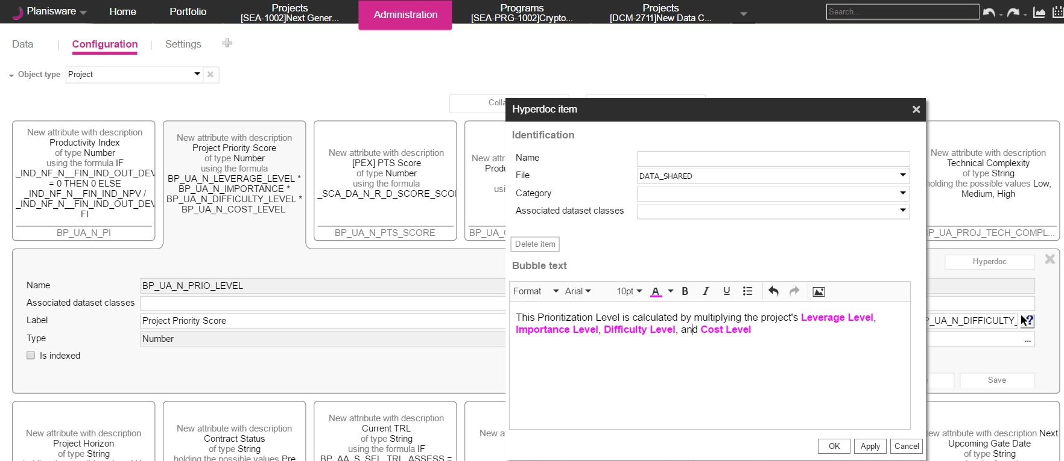
Data model markup - Hyperdoc
2
1
3
Find the attribute you wish to document
Click on the Hyperdoc button associated to the attribute
Add in the bubble text any rich text information you would like to convey to end users
1
2
3

Slide 21
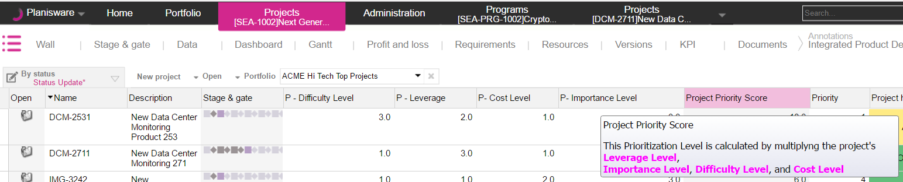
Hyperdoc

Slide 22
Attribute Settings
Scenario
Can we have more control over attributes? For example we do not want end users to be able to add sales information to their project tables. Also, our European counterparts are fed up with seeing some European Start dates in the American Format. Lastly, we need to be able to set default values. For example a project’s default description should be “Please fill me out” so users do not forget to provide a description
1
1
1
Analysis
Attribute Settings allow admins to hide attributes from table insertion, set default formats, and set default values.
For this configuration an admin needs to know: The Attributes they wish to control : Sales, European Start, Description Control Definitions: Sales – Should be hidden European Start - Should be in format DD-MM-YYYY
Project Description – Should default to “Please fill me out”
1
2

Slide 23
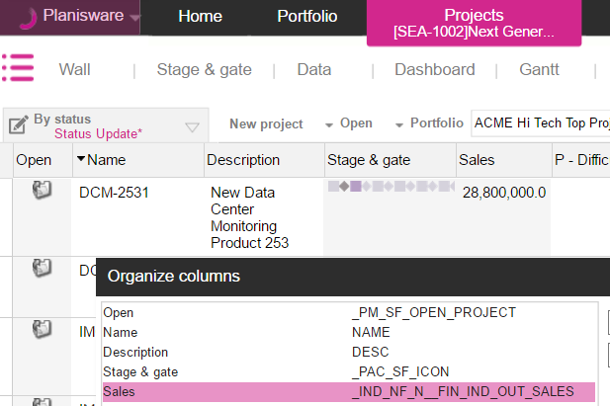
Attribute Settings – Hiding in Intranet Server
1. Find the attribute on which you want to limit information. It will help to take note of the internal nickname

Slide 24
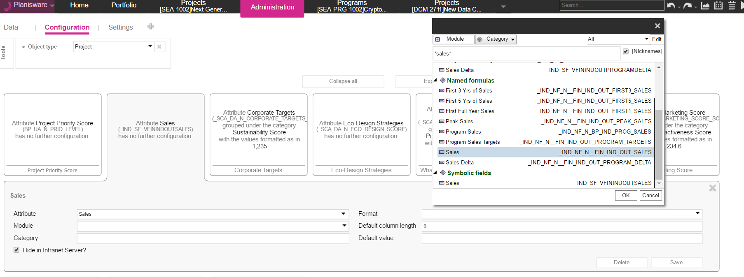
Attribute Settings
1
2
3
4
Select the correct class of the attribute you wish to limit
Find the exact Attribute for the attribute setting using the nickname
Mark hide in intranet Server After clicking Save, this attribute will no longer be available for insertion, however if the attribute is already on a table, this flag will not remove the attribute from the style
1
2
3
4

Slide 25
Exercise
Choose a user attribute you created
Verify that you can insert the attribute to a table
If the attribute it on the table, remove the attribute from the table
Hide the attribute
Verify that the attribute is no longer available for selection

Slide 26
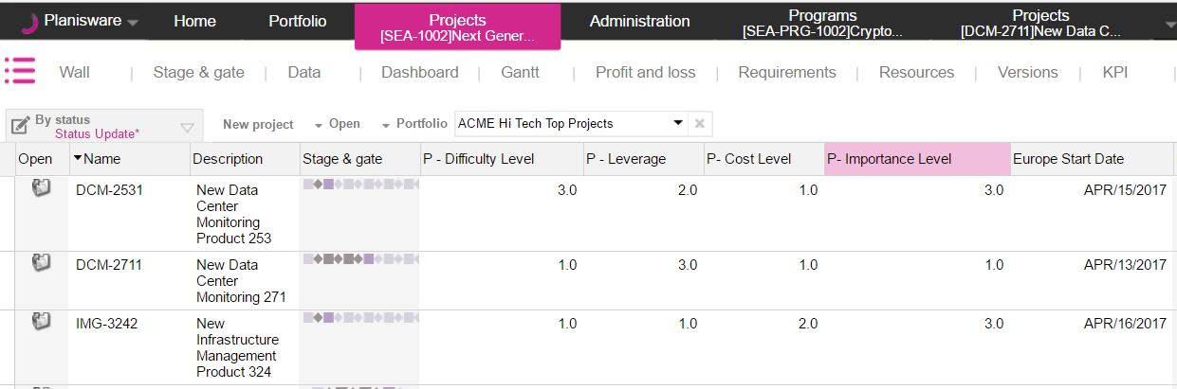
Attribute Settings – Default Date Format
1. Find the attribute on which you want to limit information. It will help to take note of the internal nickname

Slide 27
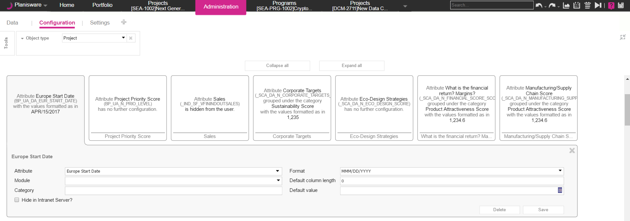
Attribute Settings
1
2
3
4
Select the correct class of the attribute you wish to limit
Find the exact Attribute for the attribute setting using the nickname
Set the Format (this picklist is dynamic based on the type of attribute) After clicking Save, this attribute will by default display in the attribute setting format
1
2
3
4

Slide 28
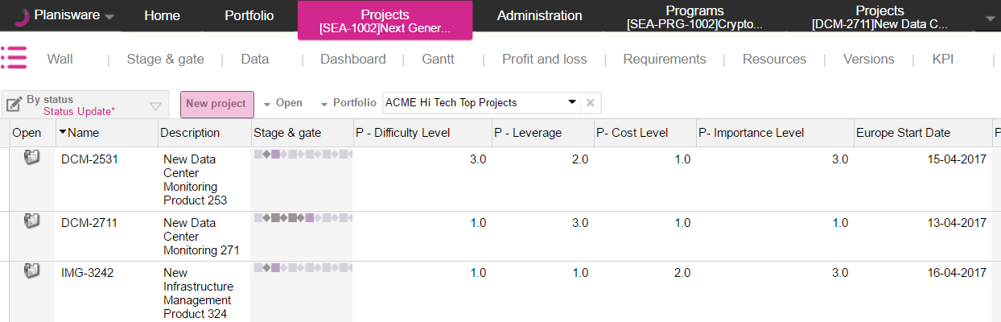
Attribute Settings – Default Date Format

Slide 29
Exercise
Create a new Date Type User attribute on Project
Set the default Date format of this attribute to “MM-DD-YYYY”
Verify that the Date format is enforced

Slide 30
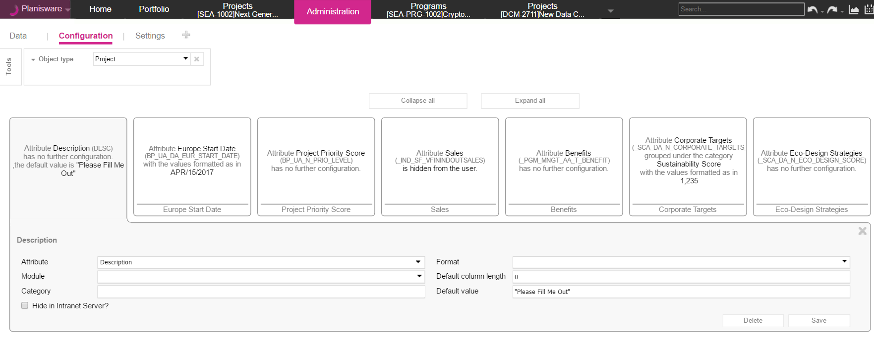
Attribute Settings
1
2
3
4
Select the correct class of the attribute you wish to limit
Find the exact Attribute for the attribute setting using the nickname
Set the Default Value After clicking Save, this attribute will by default display in the attribute setting format
1
2
3
4

Slide 31
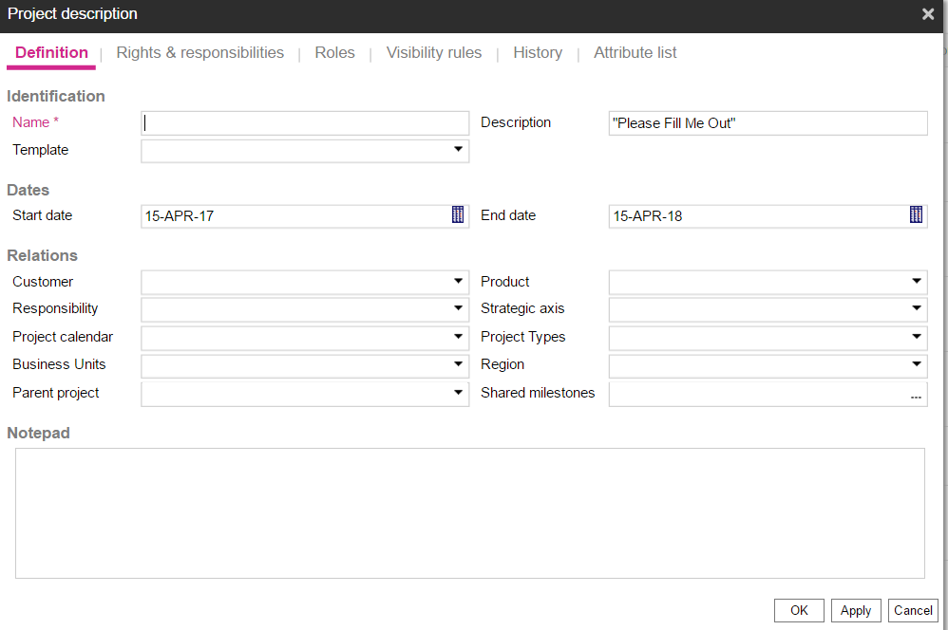
Attribute Settings – Default Value on Project Creation Popup

Slide 32
Exercise
Create a new String User Attribute with a default value of “Please change me” on class activity
Create a new activity on a project
Verify the default value of the new attribute

Slide 33
Color management- Scenario
Scenario
Our company likes to color code specific activities. Is there a way to categorize activities visually, so that some activity types that have the description “Testing” can stand out in the Gantt chart?
1
2
Analysis
Leverage color management to set specific graphical properties on Gantt elements that apply to all projects.
How to break down the situation: 1. Break down activity types and choose a color or symbol to represent them 2. Create a new color rule with an icon or symbol and color that can be viewed on the Gantt screen

Slide 34
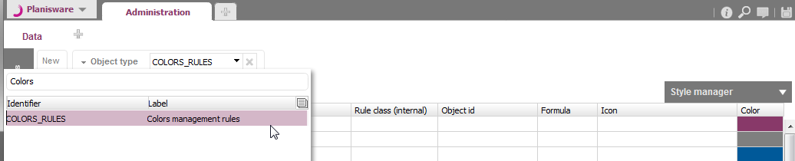
Creating new colors rules
To create a new color rule navigate to the Administration > Data page.
In the Object type field select Colors rules to display the Colors management rules table.
Click the New button to display the Colors management rules creation dialog.

Slide 35
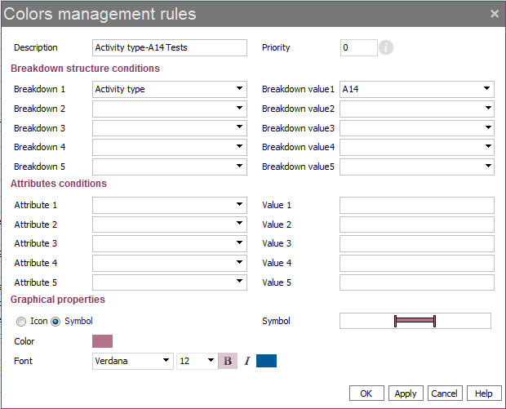
Creating new colors rules
1. Enter a Description.
Name is automatically created and corresponds to the object ONB.
2. The rule with the lowest priority will be applied first.
4. Select the Breakdown structure value on which you want to apply the rule (e.g. activity type A14)
3. Select the Breakdown structure on which you want to apply the rule.
Here, the rule will be applied on an activity type.
5. Select a Shape and a Color for the element of the Gantt representing this activity.
The defined Font will be applied in the table.

Slide 36
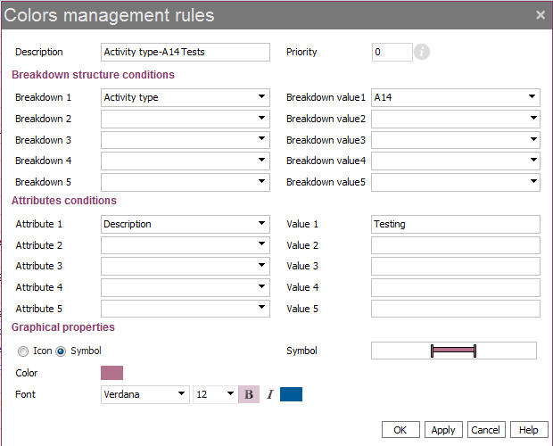
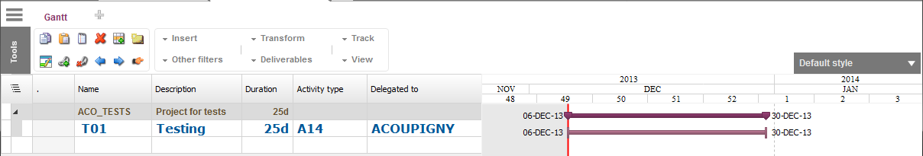
View in Gantt
Rule definition
Ex. With symbol
The rule is only applied on activity of type A14 which Description is Testing.
Result: Rule rendering in Gantt

Slide 37
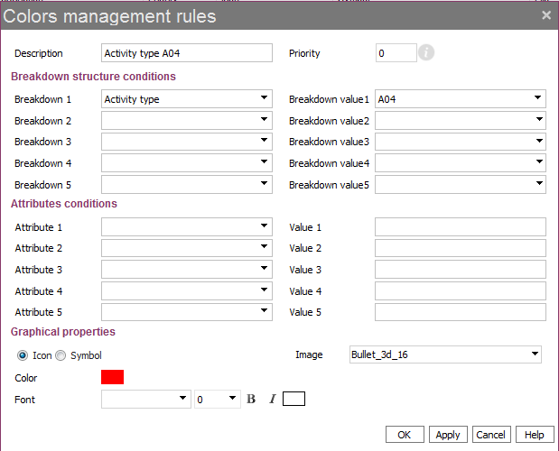
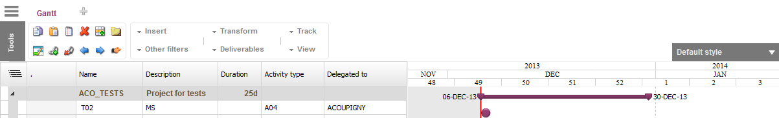
View in Gantt
Rule definition
Ex. with Icon
The rule is only applied on activity of type A04.
Rule rendering in Gantt

Slide 38
Image management - Scenario
Scenario
While the colors are working great for the activities, is there a way to add more visual elements on the list of projects or even status reports? Can we display more meaningful symbols for project health to show projects meeting targets and those that are not in the right direction (i.e. comparing EAC vs. BAC values)?
3
1
2
Analysis
Utilize new image management features to add a column on the Projects table.
How to break down the situation: 1. Import images into the image bank
2. Add a new symbolic field “Project Health” using these images
3. Display status reports for each project

Slide 39
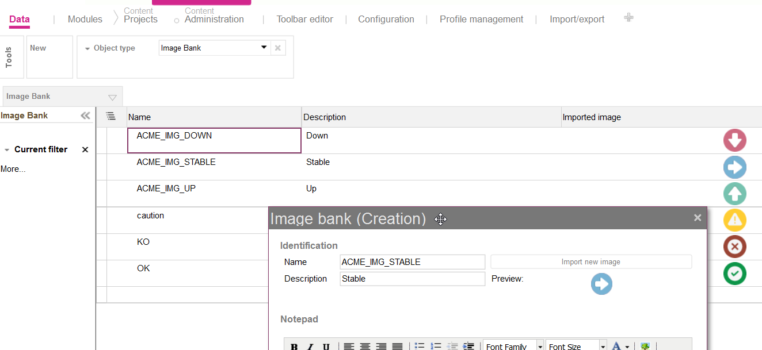
Image bank
Go to Administration > Data > Image bank to import images
These images can be used in symbolic fields or status reports
Image size should preferably be 32 x 32

Slide 40
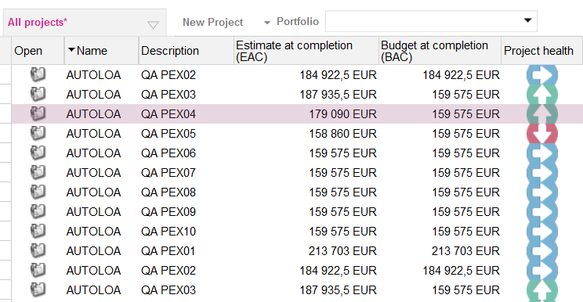
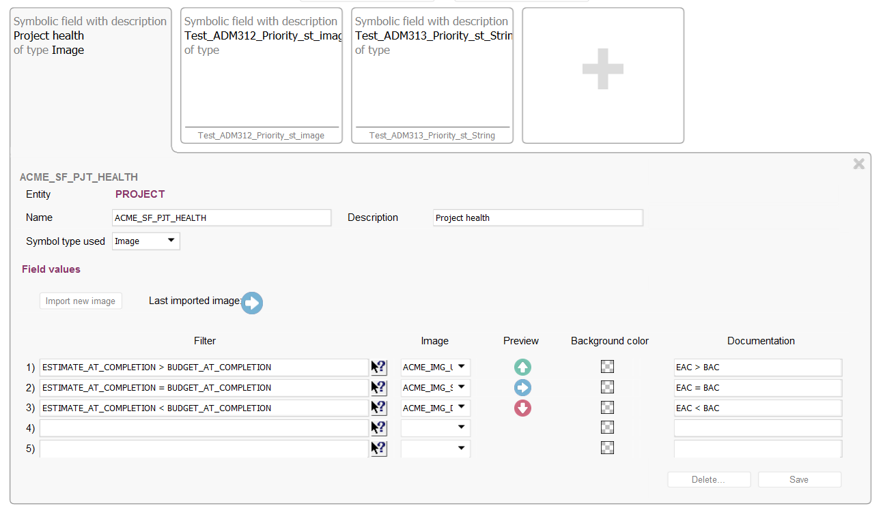
Symbolic fields
You can create symbolic fields and insert them in tables
Choose arrows to represent project health to indicate which direction the project is headed

Slide 41
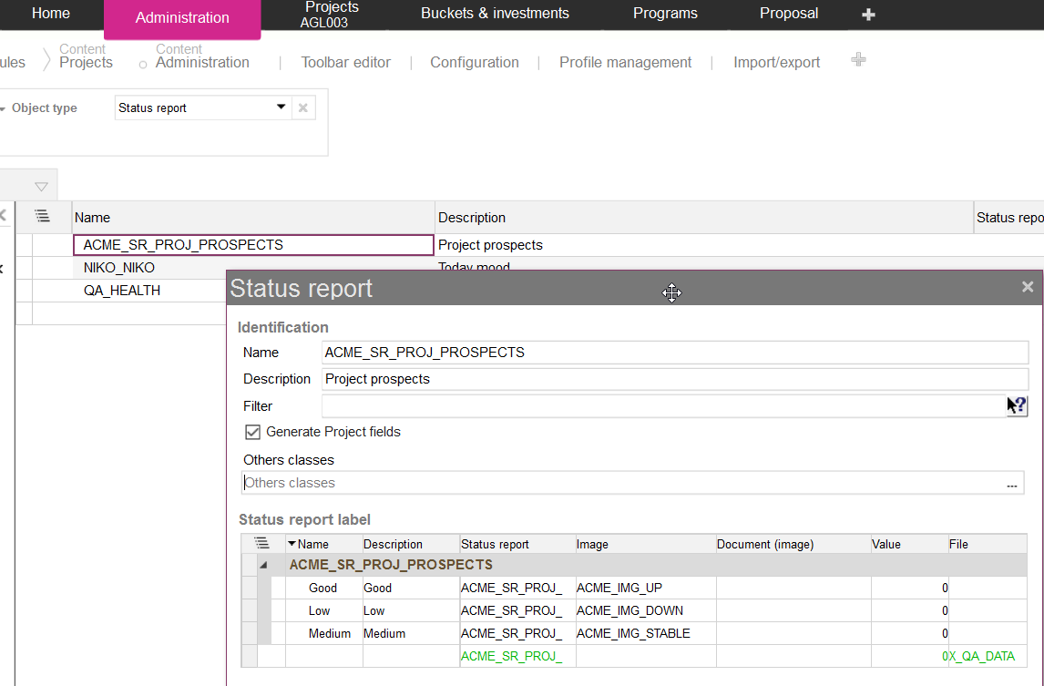
Status report
Can also use the images from the image bank on status reports
Go to Administration > Data > Status report
Check this option to make fields available on projects
Create a status report, define possible values and link images

Slide 42
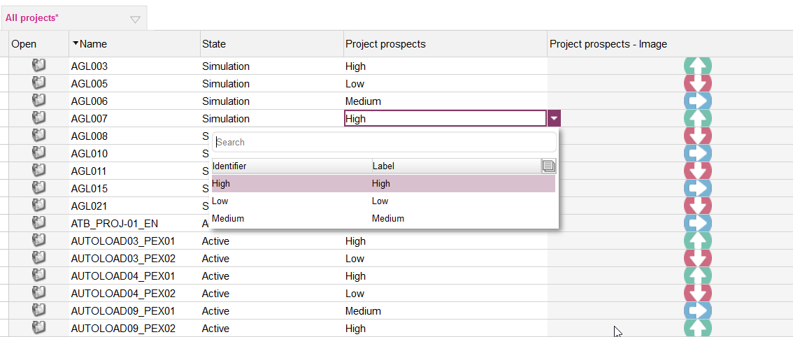
Status reports
2 fields are generated for each status report: one entry field, one display field
Pick a value in the list, the image is updated accordingly

Slide 43
Indicators - Scenario
Scenario
For visual purposes, the image management works perfectly! I would, however, like to see more quantitative metrics (ie. Net Present Value, Payback Period etc) – either using the ones defined by Planisware or by creating custom ones.
1
2
Analysis
Manage indicators to view cost metrics at a glance on the dashboard.
How to break down the situation: 1. Planisware delivers with a set of predefined indicators based on frequently used metrics.
2. Using the pre-defined indicators, you may create new custom indicators.

Slide 44
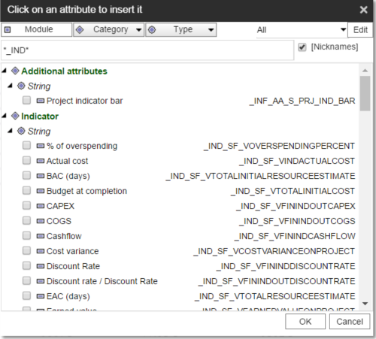
Classic Indicators
Classic indicators may be found on the project level with the keyword in the technical name “_IND”.
These may include budget at completion, discount rate, net present value, payback period, total investment etc

Slide 45
Indicator bars - Scenario
Scenario
Great! We’ve got some indicators we can work with. Rather than adding them individually on the project list though, can I view them nicely grouped somewhere within a report?
Analysis
By default, Planisware is delivered with a set of predefined indicator bars that can be deactivated. Indicators bars are designed to be displayed on dashboards based on Portal model and on Profit & Loss spreadsheets.

Slide 46
Attribute chooser style - Scenario
Scenario
Users who perform basic actions in the project module are complaining that the number of options they see is overwhelming. Can we find a way to restrict what attributes they see?
Analysis
By default, the list of attributes to insert on a class can be overwhelming. For example, users may want to simply know when a project was created and items related to their job function. To limit this list to only the relevant attributes, you can define a style in the attribute chooser.

Slide 47
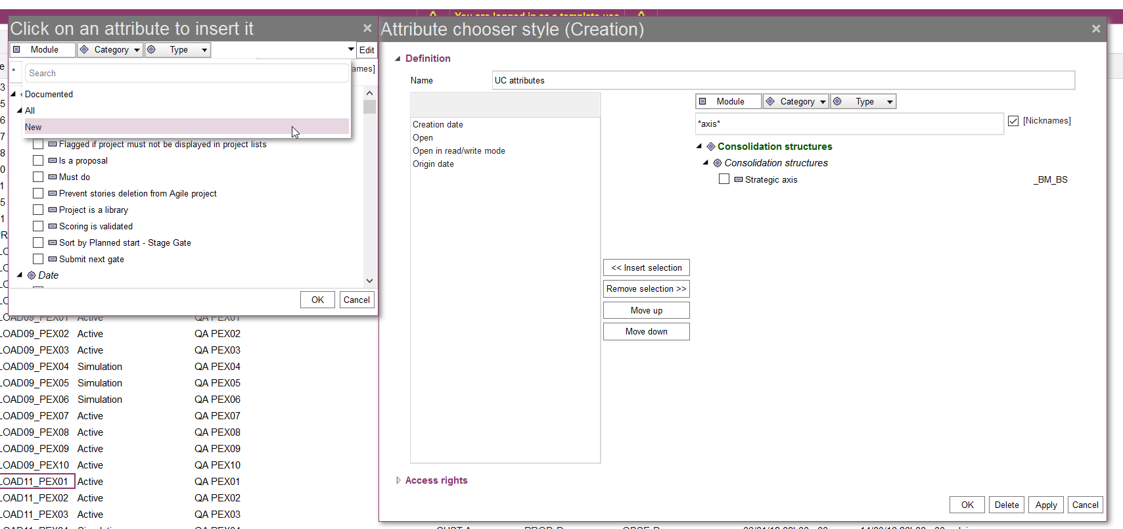
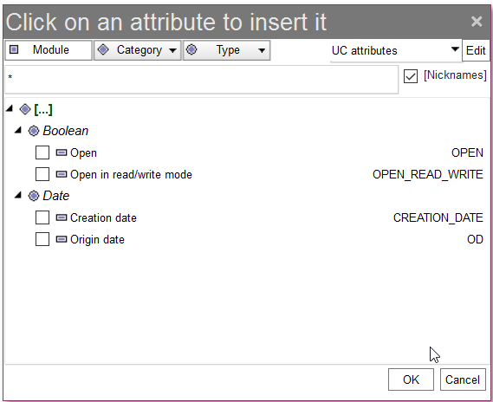
Attribute chooser style
1. Create a new attribute chooser style
2. Select the attributes you want to display
Use “access rights” to share the style
3. When the style is applied, the attribute list is filtered
Tip : To set it as default use the template user

Slide 48
Exercise
Create a new personal style for the project attributes:
Name = XX project attributes
Add your XX_UA_S_DIFFICULTY_LEVEL
Export the style to some other users
Verify from the Project page that when picking your style, only that attribute shows

Slide 49
L1 style - Scenario
Scenario
I want to be able to save the changes that I made to the view of the projects, and share this style with other users.
Analysis
By default the list of attributes you see on your screen may not align with your preferences. We discussed adding different attributes and fields according to your needs. To save this list of only relevant attributes, along with additional fields and filters, you can define a L1 style.

Slide 50
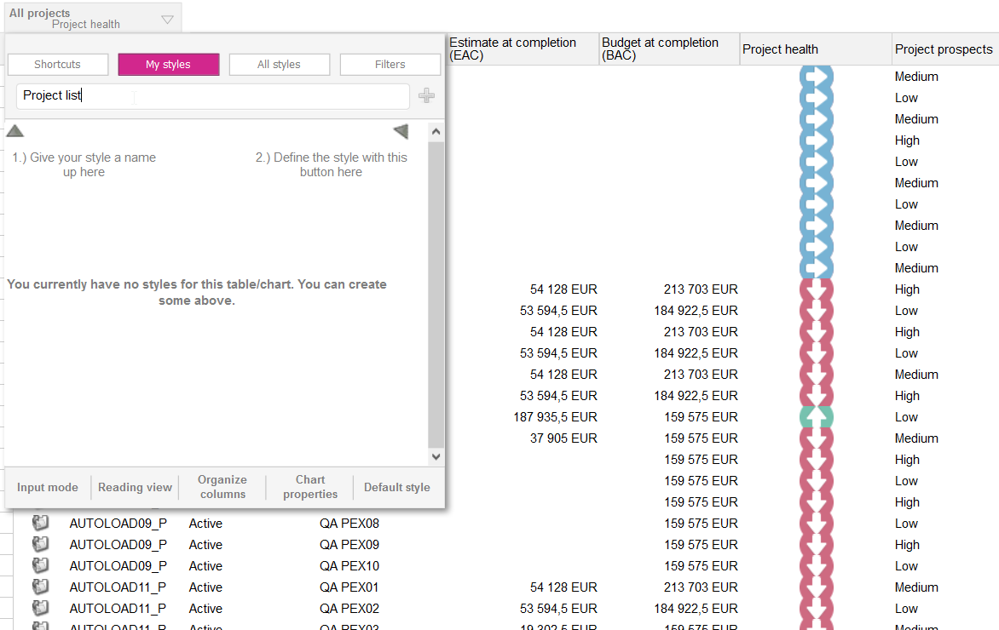
Define a L1 style
On the homepage of projects, return to the default style
Insert or remove columns
Once the layout is ready save the style as a user style

Slide 51
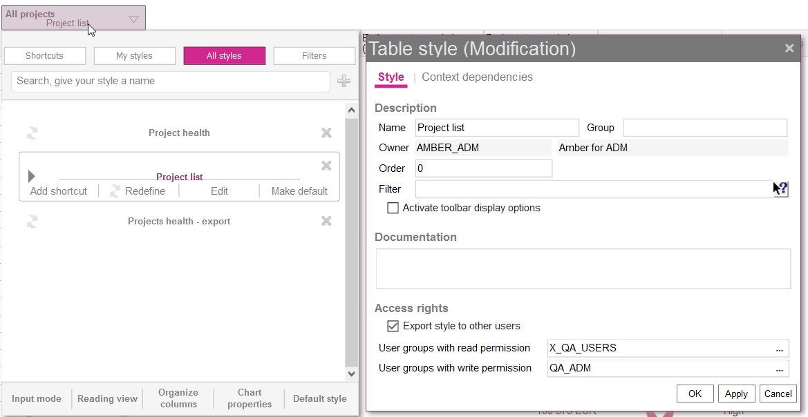
Apply and share a L1 style
Set access rights to share with other users and groups
Tip! As a Template user, make the style default. It will apply to all users of the profile

Slide 52
Text Keys - Scenario
Scenario
Nicely done! I also want to change titles of modules and some attributes to make the terminology seen on the screen more user friendly. Can this be done?
Analysis
You can modify what labels the end-users will see in the interface, by applying modifications to the standard text keys. If a label needs to be modified, it can be modified centrally, in the corresponding text key, and all the labels using that text key are modified accordingly.

Slide 53
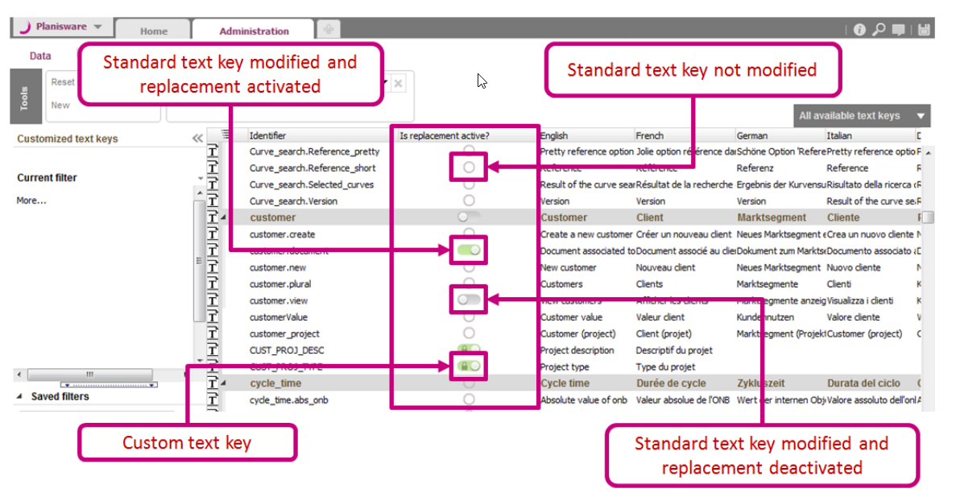
Text Keys
Is replacement active?
Column indicates if text key is replacing a standard text key and if the replacement is activated or not

Slide 54
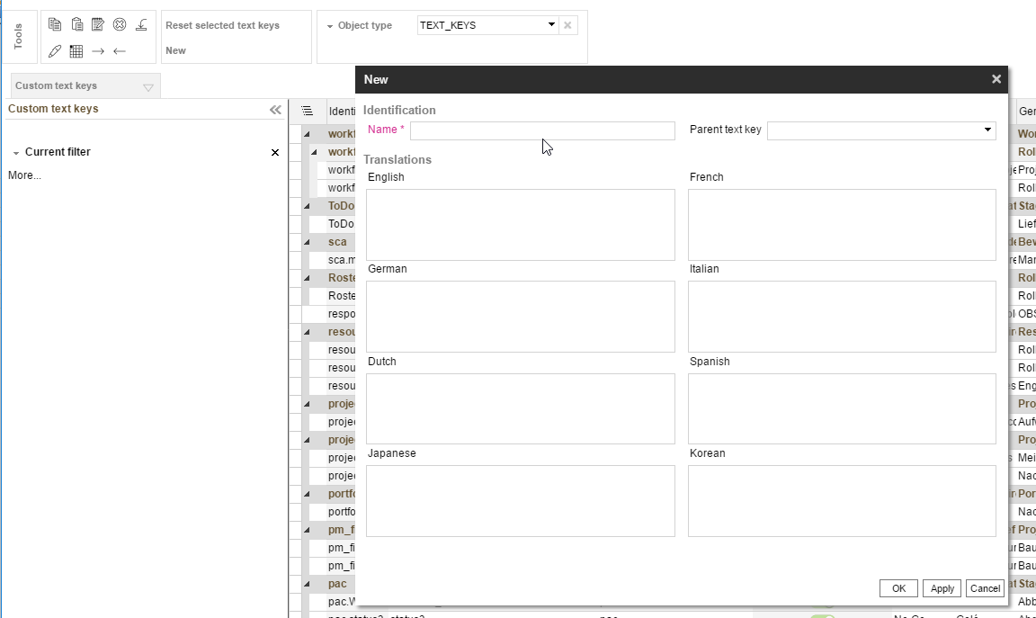
Creating Text Keys
Navigate to Administration > Data > TEXT_KEYS
1. Create a new text key
2. Name is mandatory and should not contain spaces. Select a parent key, if necessary
3. Enter the label for each language used in your system, in the appropriate zones; e.g. English label in the English zone
4. Click OK to save creation and close the dialog

Slide 55
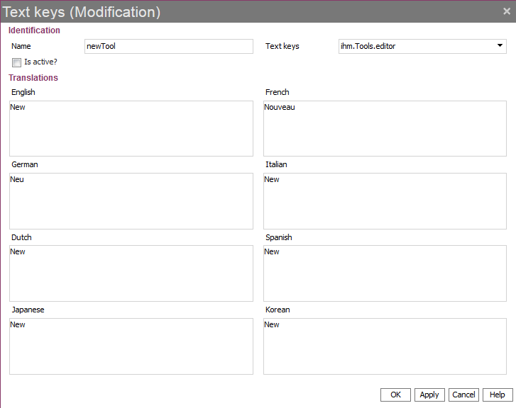
Modifying Text Keys
To modify text keys:
Double-click on the line of a text key. The Text Keys (Modification) dialog is displayed.
Modify your data.
Check the Is active? box to activate the modification.
If you do not check the Is replacement active? box, it is deactivated by default . To activate it, double-click on the icon in the “Is replacement active?” column. The icon becomes green.

Slide 56
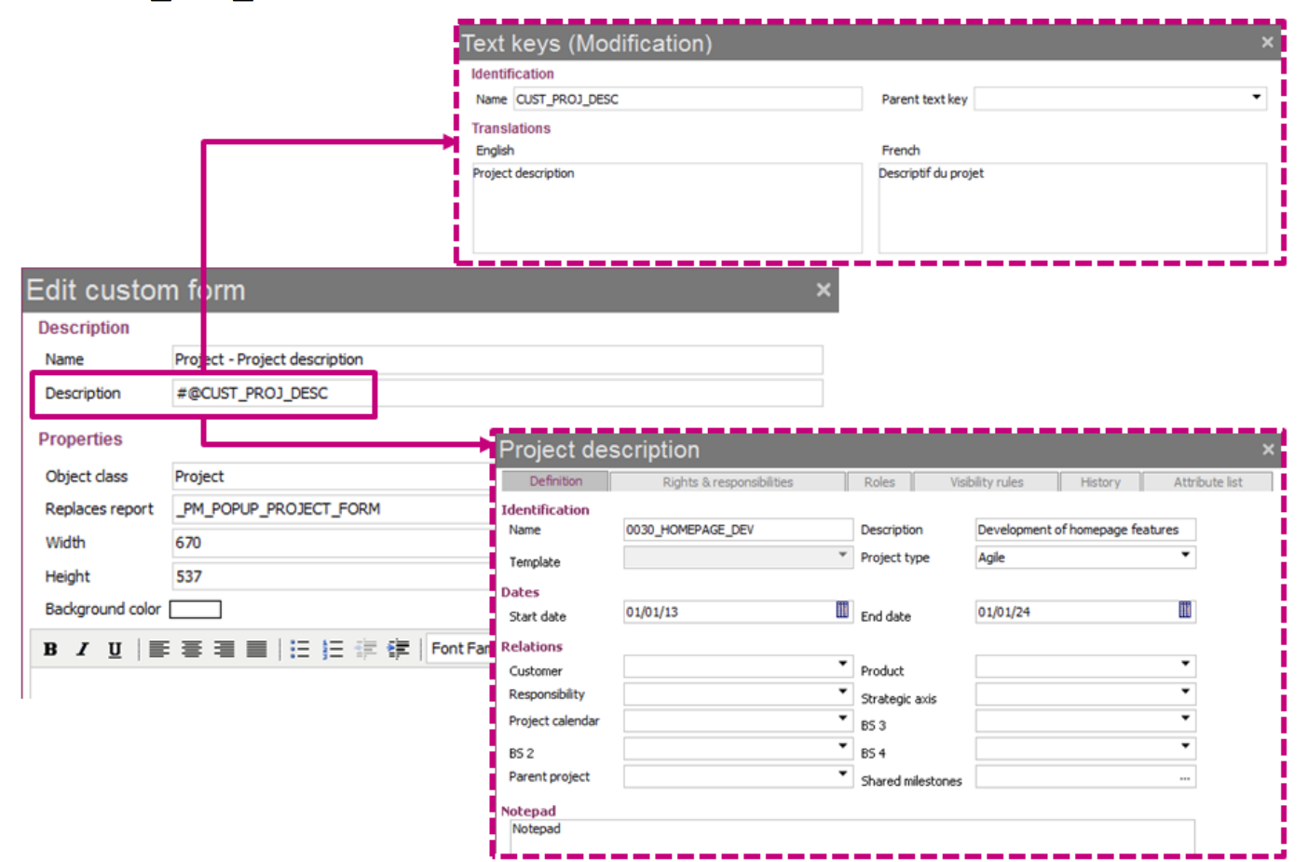
Using Text Keys
By default descriptions are used for labels in the interface
Can be entered in most Description fields
Syntax: #@<text_key_identifier>, or “Name” column of text key

Slide 57
Toolbar editor - Scenario
Scenario
All these toolbars on Planisware seem helpful but some users see unnecessary tools that they don’t use or they would like to
Analysis
You can do this easily using the toolbar editor to hide buttons directly on the toolbar.

Slide 58
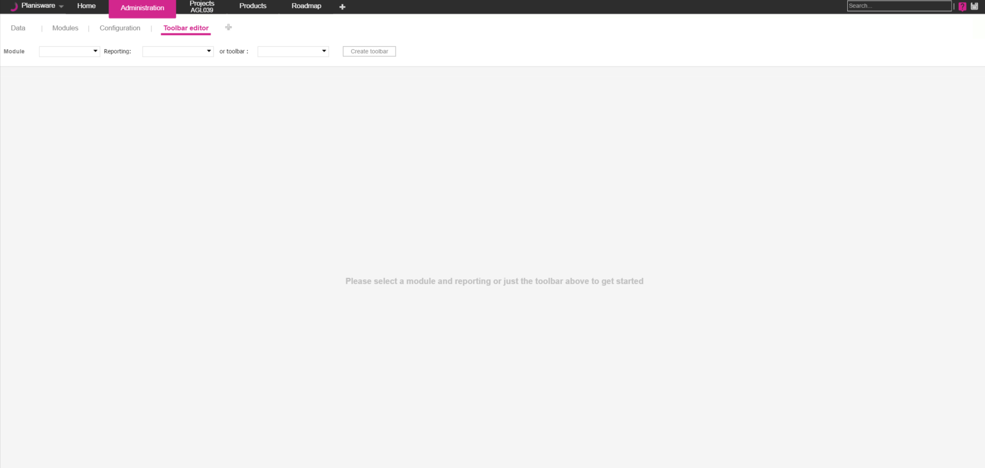
Accessing the Feature
To create a new toolbar:
Open the Administration module.
Add the Toolbar Editor page.
Select the report you want to create a toolbar for.
The list displays only the reports of the selected module for which there is no existing toolbar yet.
Select the module of the report you want to create a toolbar for.

Slide 59
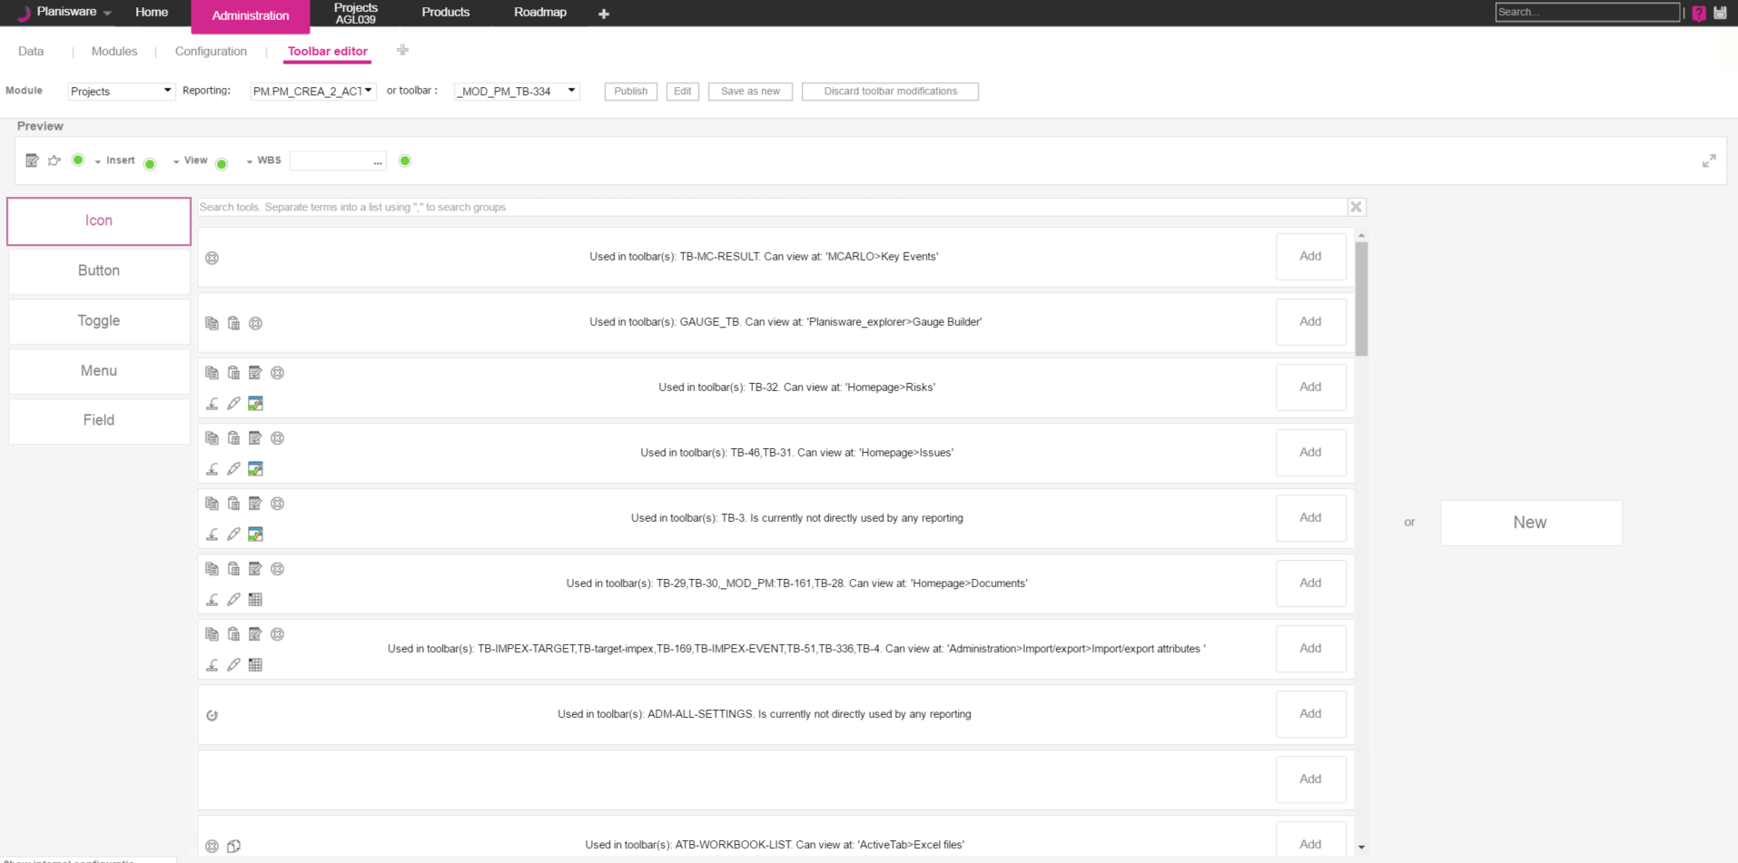
Adding Existing Tools
To add an already existing button, click the Add button corresponding to this button.
To add a tool to the toolbar, click the Icon/Button/Toggle/Menu/
Field button.

Slide 60
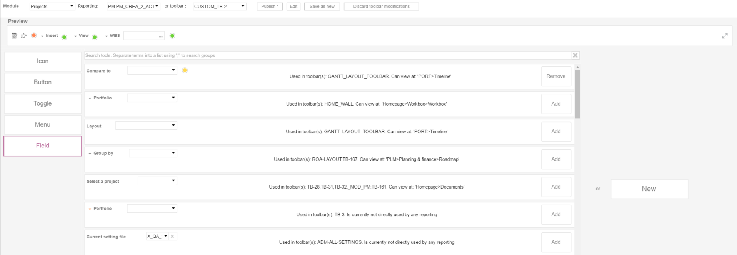
Adding Existing Tools
The tool is added to the toolbar.
A yellow dot is displayed next to the added tool. It indicates that the toolbar has not been saved yet.
To cancel adding a tool, click the Remove button corresponding to this tool.
A dot is also displayed in the list to indicate the tool that has been added to the toolbar.

Slide 61
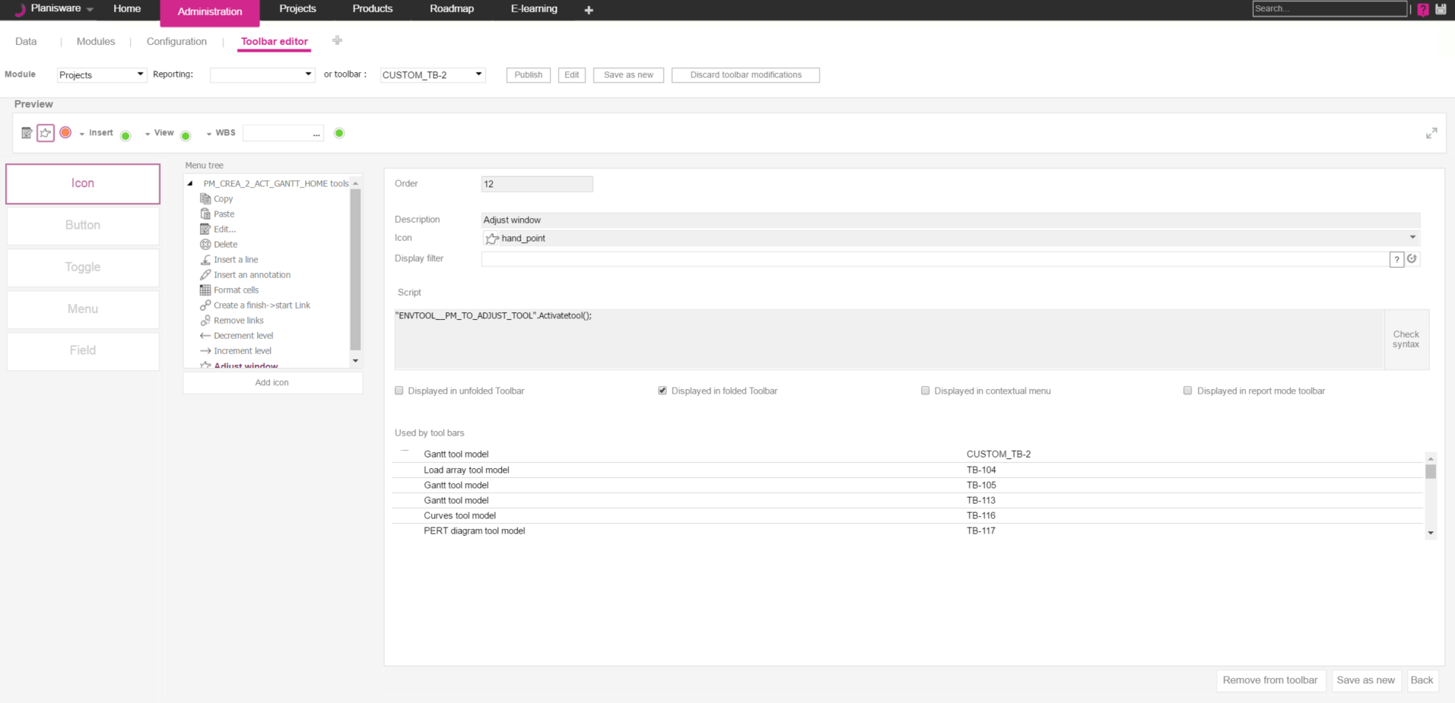
Removing Tools from Toolbar
Double click on the tool that you would like to remove from the toolbar.
Click on Remove from toolbar to delete the tool from the toolbar.

Slide 62
E-Learning - Scenario
Scenario
I can’t handle all the questions that my end users are sending over to me. Do you have any relevant documentation that can be easily searchable?
Analysis
Training materials and relevant documentation to Planisware are accessed via the E-Learning. Documents are presented via slide decks, videos, and white papers. Company specific E-learning material can be added on top of the standard E-learning material provided by Planisware.

Slide 63
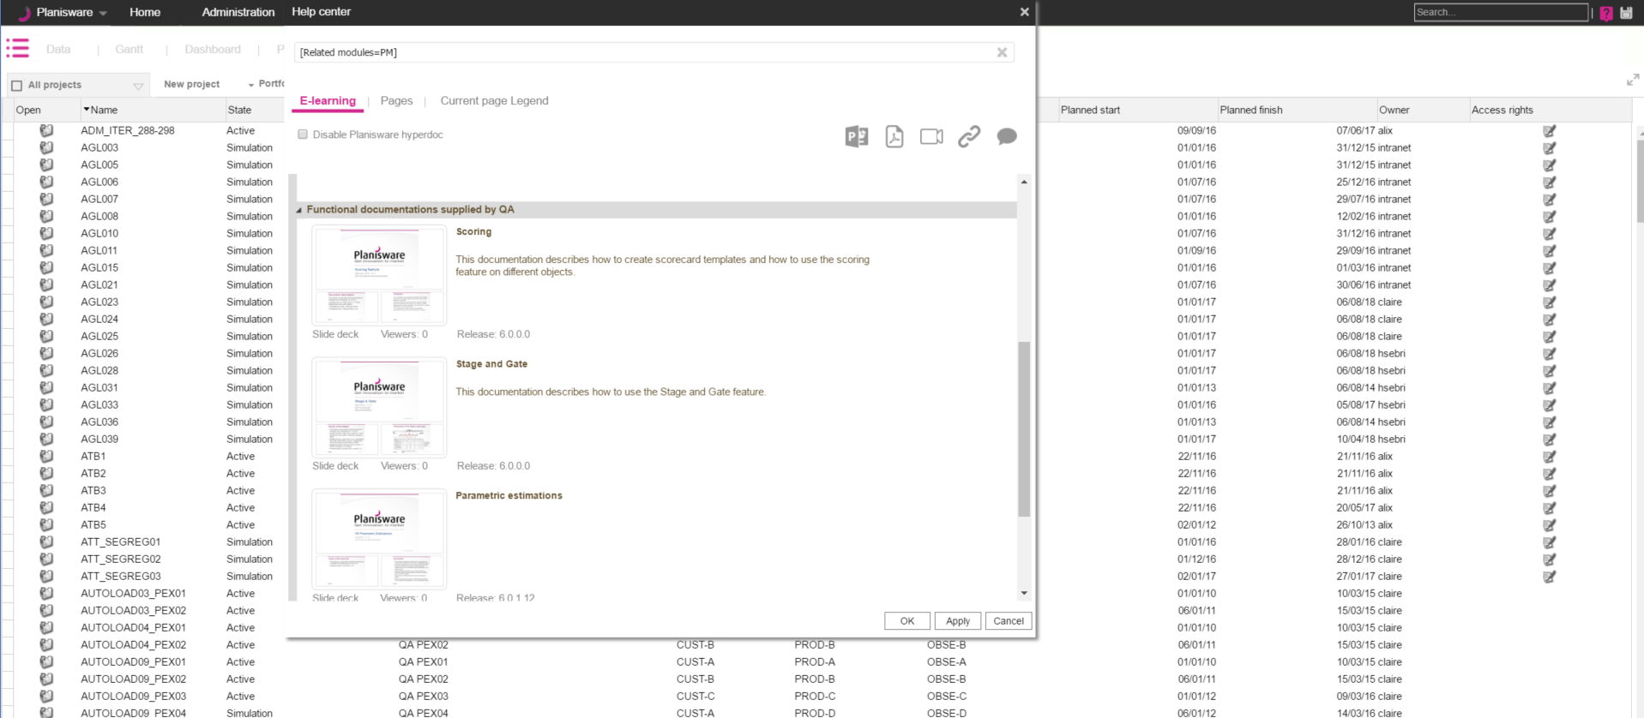
E-learning for a Module 1/2
On each page of Planisware Processes, you have access to the E-learning.
The E-learning documents available correspond to the current module.
1
2
3
1
Click
A window with the E-learning documents relevant to the module is displayed.
Click to open.
2
3

Slide 64
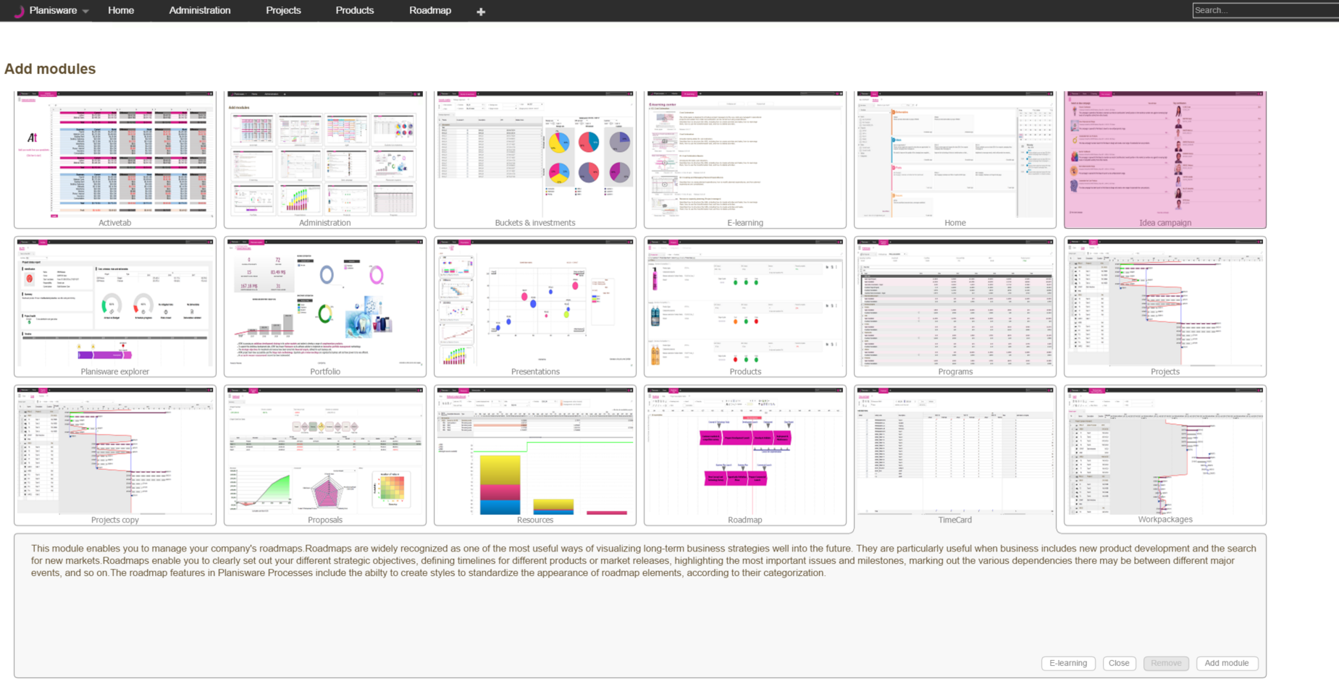
E-learning for a Module 2/2
1
2
3
1
Click the Add module button.
Click thumbnail.
Click on E-learning to open.
2
3

Slide 65
Adding a Document to the E-learning
To add a document to the E-learning:
Open to the Administration module.
Add the Modules page.
Click the thumbnail of a module.
Click the E-learning button.

Slide 66
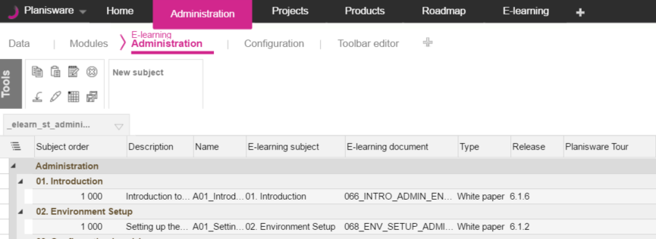
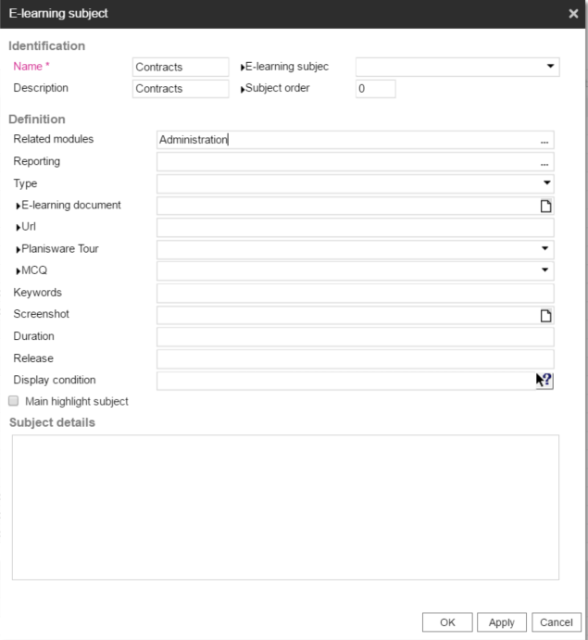
Adding a Document to the E-learning
The list of the E-learning subjects for the selected module is displayed.
If there is no e-learning subject yet, create a new one (level 1):
Click New Subject.
Enter only a Name, a Description and select related modules.
Click OK. A new E-learning subject is created.

Slide 67
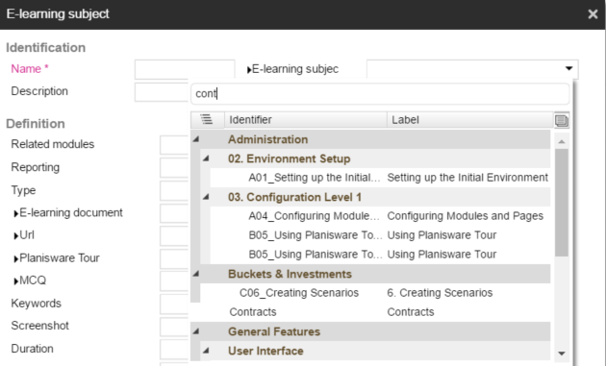
Adding a Document to the E-learning
To add a document belonging to the new e-learning subject (level 2):
Click New Subject. The E-learning subject dialog is displayed.
The newly created e-learning subject is displayed in the list. No level is defined yet.

Slide 68
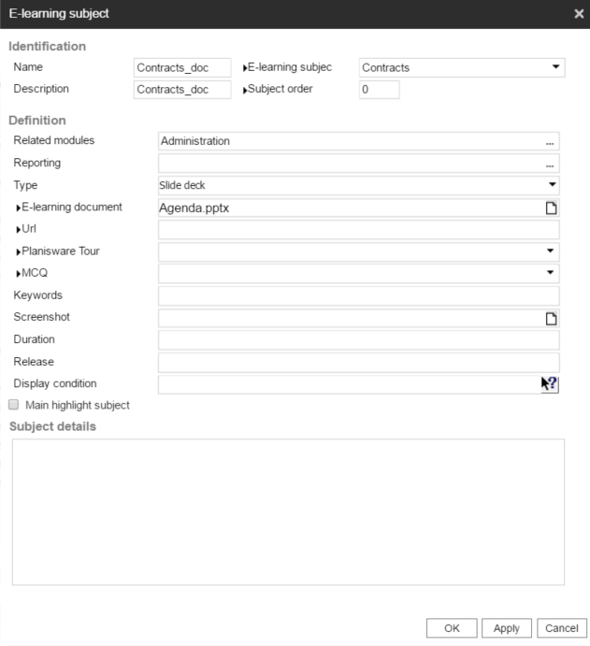
Adding a Document to the E-learning
Enter a Name (mandatory) and a Description, and select related modules.
Select the created E-learning subject.
Choose between Slide deck, Video, White paper, URL, and Planisware Tour.
Select the document that you want to add.
Click OK. The document is added to the e-learning.

Slide 69
Locks - Scenario
Scenario
Our users are changing the project state after the project has been set to active!! We need to restrict data changes on this attribute so that only Admins can change the value after a project has activated.
1
2
2
Analysis
Locks allow you to lock specific attributes to specific users or in specific situations.
How to break down the situation: Figure out relevant classes and attributes - Project: state
Figure out lock conditions : When is the lock activated?
- Locked when Active for Non Admin When is the lock deactivated?
- Unlocked when state is not Active
1
2

Slide 70

Creating locks
To create a lock:
Click the + button.
Enter a Name and a Description (mandatory).
Select attributes.
Check On all modifications to put the attribute into read-only mode. Warning: This flag prevents all objects matching the Filter from being modified at all. This means that no attributes can be modified. It is best to not use this option for performance reasons.
Check On deletion to prevent the attribute from deletion.
Click Create.

Slide 71
Exercise
Create a lock on your XX_UA_S_DIFFICULTY_LEVEL project attribute and only allow modifications if the current user is listed as the owner of the project.
Name = XX_LO_ DIFFICULTY_LEVEL
Description = XX Difficulty level lock
On modification of the following attributes = XX Difficulty level
Filter = $CURRENT_USER <> OWNER
Test the lock to make sure you can only change the difficulty level on project where you are listed as the owner.

Slide 72
Alert - Scenario
Scenario
That lock on the project state is great! We have another attribute, the project description, that we don’t want to lock, but rather ensure it is populated at all times!
1
2
Analysis
Alerts can do so many things! In this example, we will use an alert to tell the current user they need to have a description if they attempt to delete a description. But we can also alert other users, either through emailing or through notifications.
How to break down the situation: Figure out relevant classes and attributes - Project: description
Determine what needs to be done - description never blank
1
2

Slide 73

Creating alerts
To create an alert:
Changes in Data

Slide 74

Creating alerts
Select the type of the message.
Click Create.

Slide 75
Exercise
Testing activation Conditions: Alert on project creation the popup message
“Project created” (Use Naming convention XX_PRJ_CREATE)
Alert and prevent on Active State projects the popup message “Can not delete an active project” (XX_PRJ_DELETE)
Testing default Value:
Create 2 date attributes on the project with your 2 initials on the front appended with 1 ) XX_PROJECT_CREATION_DATE 2) XX_LAST_PRJ_DEL_ATTEMPT
Create 1 String attribute on project with your 2 initials on the front appended with 1) XX_ LAST_PRJ_DEL_ATTEMPT_USER
On your project created alert, set XX_PROJECT_CREATION_DATE to $DATE_OF_THE_DAY On your Deletion set XX_LAST_PRJ_DEL_ATTEMPT to today and set XX_ LAST_PRJ_DEL_ATTEMPT_USER to the current user

Slide 76
User trace - Scenario
Scenario
We have a project whose description field was changed, but we don’t know when or by whom. Is there a way to monitor changes to this field over time?
1
2
Analysis
A user trace gives administrators the ability to see a record of user actions, such as attribute modification. In addition, user traces can be used to monitor object creation and deletion.
How to break down the situation: Figure out relevant classes - Project: description Determine what needs to be done - user trace on modification
1
2

Slide 77


Creating user traces
To create an user trace:
The Information column is filled by the Information pad formula.
The User and Modification Date are logged.
The attribute value before and after the change is logged

Slide 78
Exercise
Create a user trace on your XX_DIFFICULTY_LEVEL project attribute.
Test the trace by modifying the attribute and checking the log in the User traces logs on Administration->Data page.

Slide 79
Data Management Rule - Scenario
Scenario
Our users are selecting the wrong responsibility on projects. We want them to select only level 2 responsibilities!
Analysis
Data management rules (DMR) allows you to filter the values available in a list.
How to break down the situation: 1. Figure out relevant classes - Project: Responsibility 2. Determine what needs to be done - DMR on project to filter Responsibility

Slide 80


Creating data management rules
Example 1: Displaying only responsibility level 2 on projects.
Select Projects as Object Type.
To create a DMR:
Enter a Name (mandatory) and select an Attribute.
Click the + button.
Click Save.
Only the responsibilities of level 2 are available.

Slide 81
Examples
Data Autofill DMR that autopopulates desc based on STATE + NAME

Slide 82
User Profile - Scenario
Scenario
The financial team would like access to projects and reports.
1
2
Analysis
User profiles are designed to grant access to modules and functionalities for several users. Profiles are also used to define the default pages and tabs that should be displayed when first connecting to the application.
How to break down the situation: 1. Determine what needs to be done - New user profile 2. Granting Access to Modules and Functionalities

Slide 83

Creating Profiles
To create a new profile:
Open the Administration module.
Add the Profile Management page.
Click New profile. The Create/Edit profile dialog is displayed.
Enter a profile name and description.
Setting file : if left empty same default settings will be applied for all profiles.
Click OK.

Slide 84

Updating Profiles
To update a profile:
Open the Administration module.
Add the Profile management page.
In the table, click on the name of the profile you want to update. The Create/Edit profile dialog is displayed.
Update your data.
Click OK. The profile is updated.
Parameters and functionalities granted to the profile.

Slide 85
Access Rights - Scenario
Scenario
Every users can create projects. We need to restrict the creation to Project Managers.
2
1
Analysis
Once a profile has been created, the administrator can define the modules and functionalities to which the profile has access.
How to break down the situation: Figure out relevant profiles -Profile: Every profiles besides PM
Determine what needs to be done -Revert Project Creation functionality
1
2

Slide 86

Granting Access to Functionalities
To grant access to functionalities such as project creation or shortcuts management :
In the Administration module, on the Profile management page, click the Functionalities shortcut. The list of the profiles and functionalities is displayed.
The functionality is selected.
The functionality is deselected.

Slide 87
Granting Access to Functionalities
Functionality
Idea campaign manager | Allows users to create idea campaigns.
Monte-Carlo-Simulation | Allows users to access to the Monte-Carlo simulation
Project creation | Allows users to create new projects.
Project template creation | Allows users to create new project templates.
Scorecard scoring and template management | Allows users to define scorecards
Scoring | Allows users to enter score on scorecards
Shortcuts management | Allows users to edit the shortcuts in the Style Manager menu.
Stage & Gate | Gives users access to the Stage & Gate page in the Project management module.
TimeCard | Gives users access to the TimeCard pages in the Team member module.
Tools for simulations | Allows users to create a portfolio simulation in the Projects module.

Slide 88
Granting Access to Parameters
Parameter | If the parameter is allowed in the Style Manager menu, the user can
Hide attribute profile tools | Not use the 'New' and the 'Edit' buttons in the Attribute chooser dialog
Limit access to folder changes within OPX2 IS to the following list of users or groups | Add styles as shortcuts
Limit access to style export within OPX2 IS to the following list of users or groups | Export styles
Limit columns organization of tables within OPX2 IS to the following list of users or groups | Use the Organize Columns button
Limit style updates within OPX2 IS to the following list of users or groups | Update styles
Limit the access to advanced chart parameters within OPX2 IS to the following list of users or groups | Use the Change chart properties button

Slide 89

Defining Default User Flags
When creating a new user or assigning a user to profile, the user will inherit from the values defined here.
To define the default user flags:
In the Administration module, on the Profile management page, click the User flags shortcut. The list of the profiles and parameters is displayed.
The flag is activated for the users having this profile.
The flag is activated for the users having this profile.
The flag is activated for the users having this profile.
Note: It is possible to change the flags for a particular user.
Note: It is still possible to manually modify the user flags after the creation of the user or after assigning a profile. This will not update existing user rights.

Slide 90
Configurable reports
Scenario
As our company is expanding globally, we need to keep track of more attributes. Some of our reports will need updating, like the adding the field “Country” to the Project form. What is the easiest way to do this?
Analysis
Use the form builder to get the desired layout and fields by updating an existing report.
How to break down the situation: 1. Copy the project form by creating a configurable report. 2. Create a new color rule with an icon or symbol and color that can be viewed on the Gantt screen

Slide 91

Create the Configurable report
A copy of the form is generated, ready to be modified
Reporting toolbar : to align, color, copy, paste…
Decide which tab to use :
- the original one,
- the new one,
- or if it should be hidden
Then publish it
Available attributes and widgets : drag & drop to add them to the form

Slide 92




Update project properties form
Form builder: "Associated country" is now displayed
Final result after publishing it
Original: no "Associated country"

Slide 93
Status reports
Scenario
We need a universal method of defining the status on different projects that can be changed by different users. Can we have meaningful symbols to along with this status information as well?
Analysis
It is possible to define some common report values on projects. Those report statuses allow users to share a common list of statuses on their projects.
How to break down the situation: 1. Create a status report s
2. Create a corresponding status report label to use on Walls.
3. Select images or documents to link on these reports.

Slide 94


Creating Status Reports and Labels
To create a status report:
Open the Administration module.
Add the Data page.
In the Object type field, select Status report.
Click the New button. The Status report dialog is displayed.
Enter the identification of the status report.
Note: In the Filter box, if you enter $CURRENT_PAGE_OBJECT_ID=ID, this status report is created only from the user wall.

Slide 95


Displaying Status Trend
The status report displayed on the User wall.

Slide 96
Exercise
Create a new project status:
Name = XX_PROJECT_STATUS
Description = XX Project status
Generate the project fields
Labels are: Green, Yellow, Red
Verify you can post a new status on your project wall.
Verify the status fields for the project are set according to the status you created
Verify that the trend indicator works

Slide 97
Workflows
Scenario
Simple workflows allow you to quickly set up a process in which different responsible parties can be assigned to each step.
Analysis
Simple workflows allow you to quickly set up a process in which different responsible parties can be assigned to each step.
How to break down the situation: 1. depends on the workflow!

Slide 98

Workflow attribute sheet
Enter a Name and a Description for the workflow.
By default newly created workflows are deactivated.
It is possible to activate them once they are built with all steps.
It is possible to enter a Filter so the workflow is available only on object types matching the filter condition.
The Enter the workflow only once option means that once last action has been executed then workflow will not be available anymore for the object.
If this option is unchecked then object will reenter the workflow endlessly.
It is possible to select a Report.
The link available in the ‘Responsible’ and/or ‘Informed’ user e-mail or message will point at a popup with the report set and its corresponding actions.

Slide 99

Build your workflow
Create the first step
Enter a label for the Step.
Specify Responsible user(s) for the Step: the user(s) in charge of executing the action.
The list of Responsible is plugged on the roles.
When doing modifications on the current Step you need to save them.
Click on the + to add a new step.
Specify Informed user(s): the user(s) receiving emails when action is executed.
The list of Informed is plugged on the roles.

Slide 100
More about workflows
Drag a step and drop it over another to create new nodes
Cannot create cycles
Once you’ve entered the first step of the workflow a Back to button will be available to get the object back to a previous step of the workflow
Reports can be set on the workflow

Slide 101


Workflow Example

Slide 102
Import Export
Scenario
Our team has information about the I don’t want to have to enter all this information manually in excel all over again. Can we have an efficient way to do this, especially if we have to do this multiple times in the future?
Analysis
Import-export feature is available in configuration level 1. This interface has been designed to facilitate the import and the export of data from/to an external file (.csv or json file) from/to a Planisware table.
How to break down the situation: 1. Define a mapping for the columns that need to be exported using an import/export format
2. Define a new import/export target which allows the system to export the data from a Planisware table to the target .csv file

Slide 103

Define import export format
Go to Administration > Import-export format to define a new export format
Select the object class to export
Tip! pick a pre-defined user style from the list to populate the format

Slide 104

Define target and export data
Define a new import/export target, then click “Export” to generate the csv file in the specified folder
Pick the format in the list
Set the path of the exported file
Click “Export” to generate the file
Log of the previous exports

Slide 105
Code generator
Scenario
Is there a way to automatically name some tasks so users who create them don’t need to come up with names for them?
Analysis
You can now create sequence generated code and allocate this value, as a default value, whenever an object is created.
How to break down the situation: 1. Create the code generator on the task class 2. Update the Attributes default value of the task class to use this newly created code

Slide 106


Sequence generated code
Navigate to Administration > Configuration. Select the object type you want to create the code on. Press the plus icon under the Sequence generated code to create a new one.
Enter a Name for the Sequence generated code
Enter the desired formula in the field Code generation formula
Under Attribute settings, change the default value for the Name attribute. Allocate code generator as default value (uppercase and between "")

Slide 107



Sequence generated code
When you create a new task, code generator is displayed in NAME field
2- Sequence generated code is also visible in table (switch to "Input mode)
1- Once the object is created (click "Apply"), sequence automatically generates its code for the name

